Slide 1
Game Design
Workshop #2
STANFORD | CODE IN PLACE
Hosted by HTA Ngoc & HTA Casey

Slide 2
Type a game you played this week in the chat!
If you didn’t get a chance to play a game this week, type a game you’re looking forward to playing soon!

Slide 3
TABLE OF CONTENTS
01.
02.
GAME EXAMPLES
GRAPHICS + TOOLS
03.
04.
05.
PRACTICE!
ADVICE
FUTURE STEPS
Previous Final Projects
Short Review + Toolbox
Let’s Practice
Project Advice + Tips
Resources Beyond CiP

Slide 4
01.
Game Examples
Previous Final Projects from CIP4

Slide 5
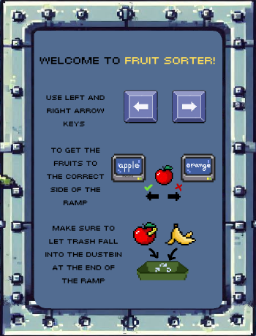
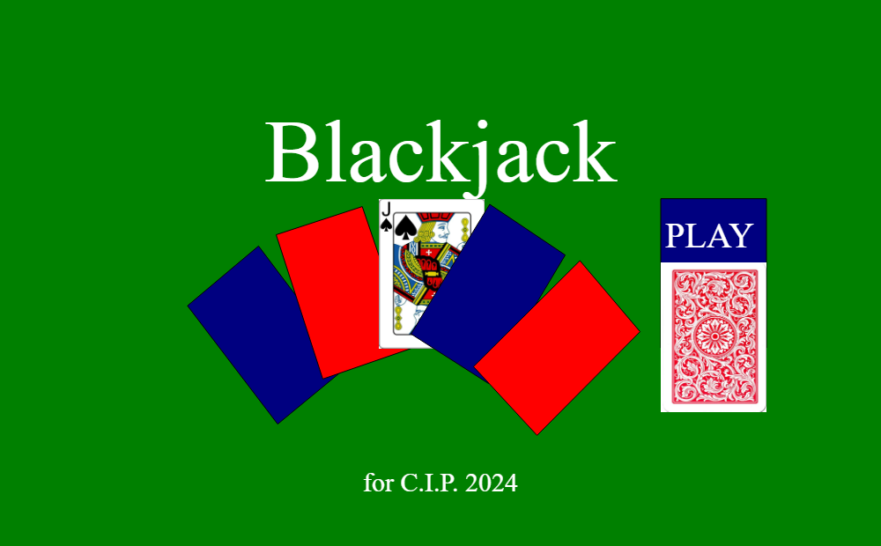
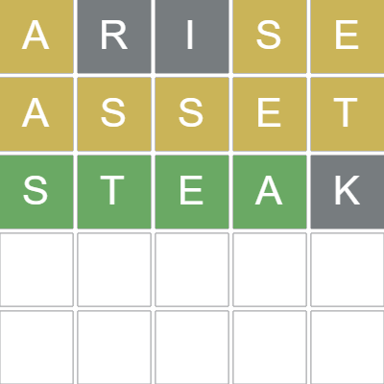
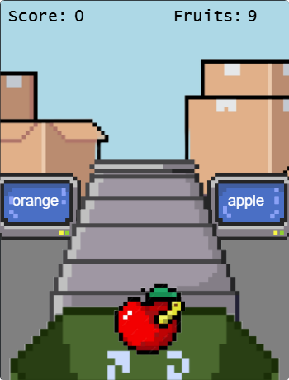
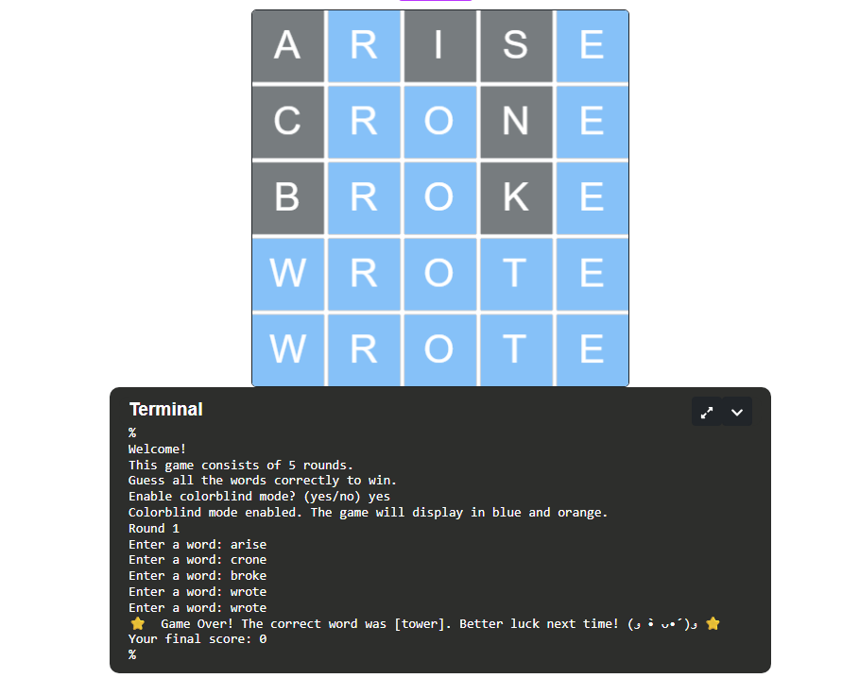
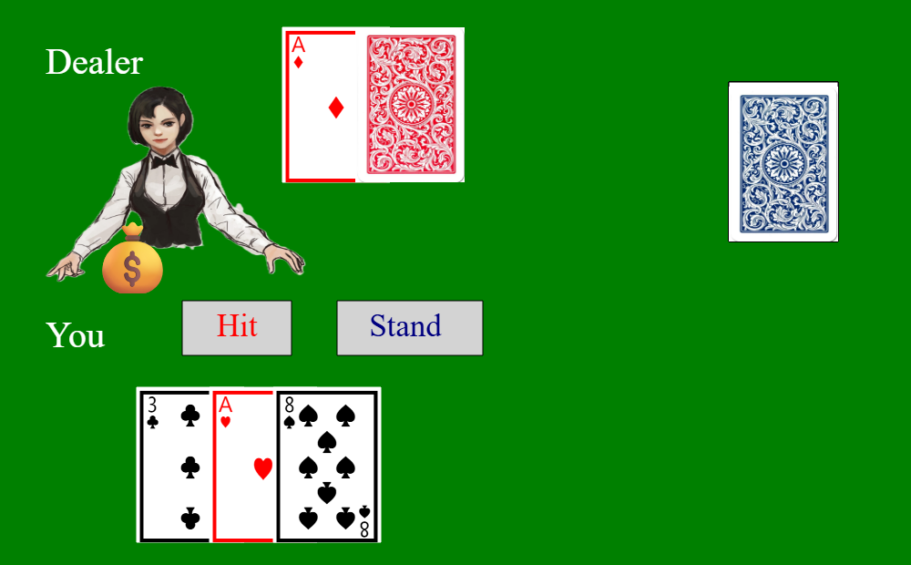
Wordle by Jihyun K
Fruit Sorter by Lubaba H
Blackjack by Aslihan T

Slide 6
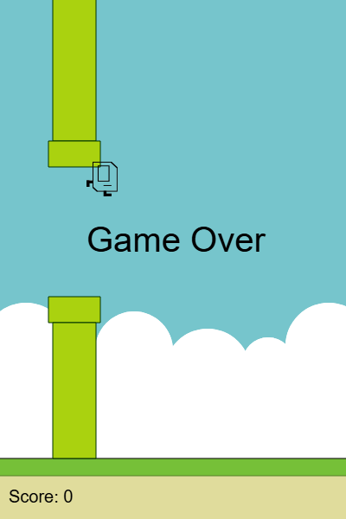
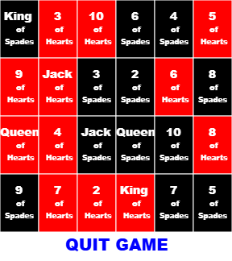

Color Match by Ngoc D
Flappy Karel by Ken T
Memory Card Game by Sylvia K
Feel free to look at more CIP4 projects at this link

Slide 7
02.
Graphics Library
Short Review & Toolbox

Slide 8
Quick Review About Graphics Library
What is graphics capable of doing?
Making a canvas of different sizes → like a game window!
Shapes
Rectangles
Circles
Polygons (including triangles)
Lines
Text
Images
Tracking user input
Clicks
Mouse Movements
Keyboard Buttons
Setting and getting properties of shapes and objects
Check out the documentation within the IDE of graphics projects!

Slide 9
Let’s Play with the Graphics Functions for ~10 mins
Feel free to ask questions as we go!

Slide 10

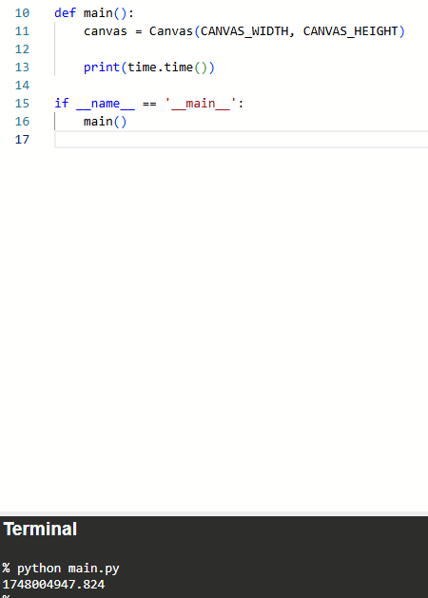
Other Useful Built-In Python Libraries
Library - a collection of prewritten code and functions that you can import and use
Random
import random
random.randint(1, 10) → returns an int from 1-10 inclusive
random.choice(list) → return an item from list
Time
import time
time.time() → returns time in epoch
time.sleep(x) → pauses your entire code for x seconds
Math
import math
Look here for doc

Slide 11
03.
Let’s Practice
Feel free to follow along on your own IDE!

Slide 12
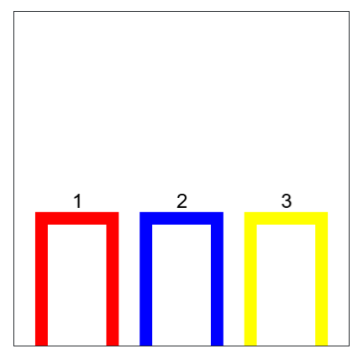
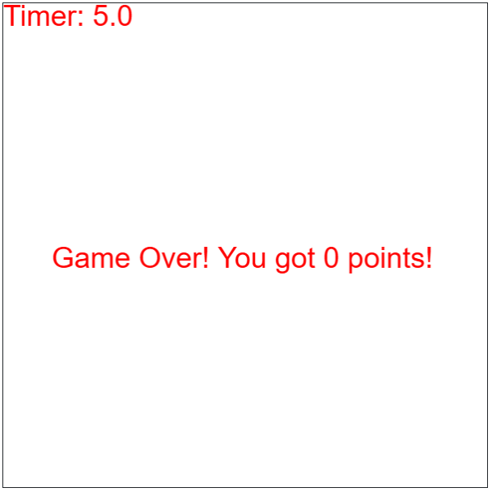
Doors - Clicking
Making a Timer & Displaying Text

Slide 13
04.
Advice
Project Advice + Tips

Slide 14
Tips For Getting Started
Abstraction – think about the big picture first. Focus on the key features, aspects, and ideas behind your game.
Can you separate your key features and ideas into chunks? Building little by little helps you debug and perfect each piece individually.
What elements do I need to track? I should use variables for these trackable things!
Decomposition will be your friend – what kind of functions might I need to accomplish each piece? Make a list!
Test regularly! Make sure things are going smoothly. Account for possible edge cases, win/lose conditions, etc.

Slide 15
Walking Through an Example
I need a way to randomly select a 5-letter word for the answer.
I want to make a Wordle copycat!
I need a way to check if the user’s guesses are right and which letters are right or almost right.
I need a way to get the user’s guesses.
It would be nice to have a start screen with instructions.
It would be nice to track their stats.
I need a way to display the user’s guesses on a grid of 6 rows.

Slide 16
Walking Through an Example
My Wordle Game Plan – separating the ideas into milestone pieces
RANDOM WORD: Have a list of 5-letter words. Randomly select one of the words as the answer.
USER INPUT: Use the input function to get the user’s guess.
CHECK INPUT + GRAPHICS: Process their input and check it against our answer string (lots of conditionals).
check if the string matches → if it does, they won!
check if it contains any of the letters → make updates on graphics and repeat.
this might need to be broken down into smaller milestones
WINNING SCREEN: If they won, then end the game, and show them a winning screen.
LOSING SCREEN: If they run out of tries, then end the game, and show them a losing screen.

Slide 17
Tips For Getting Started
Abstraction – think about the big picture first. Focus on the key features, aspects, and ideas behind your game.
Can you separate your key features and ideas into chunks? Building little by little helps you debug and perfect each piece individually.
What elements do I need to track? I should use variables for these trackable things!
Decomposition will be your friend – what kind of functions might I need to accomplish each piece? Make a list!
Test regularly! Make sure things are going smoothly. Account for possible edge cases, win/lose conditions, etc.

Slide 18
Walking Through an Example
My Wordle Game Plan – breaking down the first step
Have a list of 5-letter words. Randomly select one of the words as the answer.
I will make a function called select_word().
Store a list of strings in a WORD_BANK variable
Use random.randint() to pick a random integer 0 to length of WORD_BANK - 1 and save as random_int variable.
Return word_bank[random_int] → will learn more about lists in Week 6! (or maybe you learned about random.choice(list) from this workshop and want to use that instead…)
Once I finish writing this select_word() function, I’d probably want to test it out.
Call this function in main and store it’s returned value into a variable called answer.
Print answer. Did I get an error while running my code? Did I get a string? Is it one of the 5-letter words? Keep running and checking to see if the answer string is randomized properly. # I can delete this print statement after I finish testing

Slide 19
Tips For Getting Started
Abstraction – think about the big picture first. Focus on the key features, aspects, and ideas behind your game.
Can you separate your key features and ideas into chunks? Building little by little helps you debug and perfect each piece individually.
What elements do I need to track? I should use variables for these trackable things!
Decomposition will be your friend – what kind of functions might I need to accomplish each piece? Make a list!
Test regularly! Make sure things are going smoothly. Account for possible edge cases, win/lose conditions, etc.

Slide 20
05.
Future Steps
Resources Beyond CiP

Slide 21
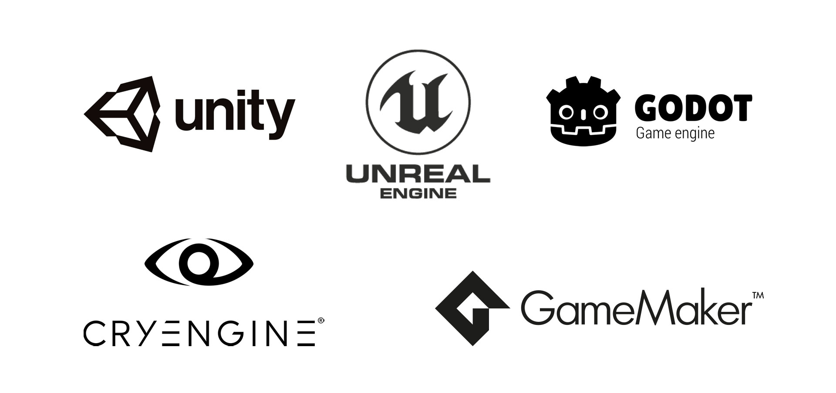

Pick a Game Engine
C++
GDScript (like Python), C++/C#
C#
C++
GML

Slide 22
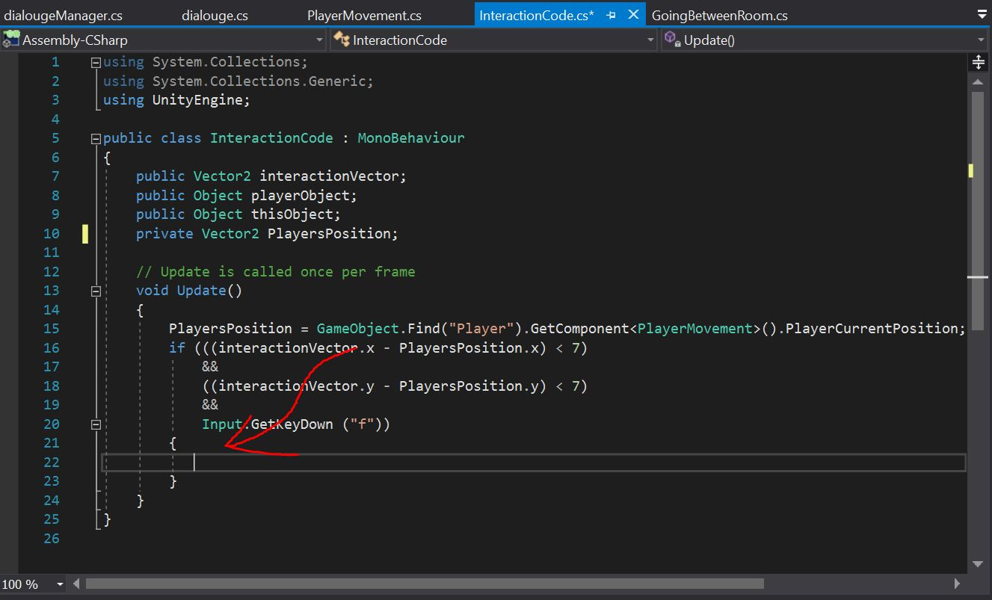
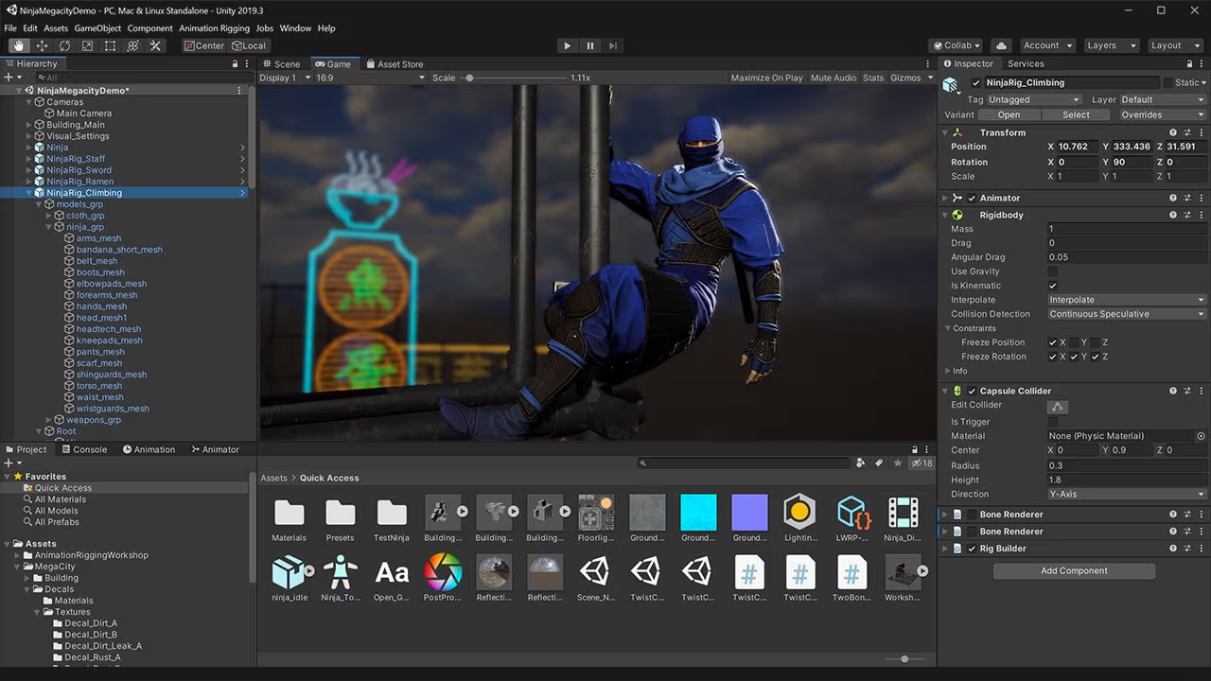
Don’t Be Afraid!
You Know How To Code Now!
import statements
variables
a function
if and conditions

Slide 23
Summarizing Advice
Watch videos, but try to understand and apply
“Spaghetti code” → our guest speaker last time talked about this
Unity has free lessons → Matt suggested taking notes on these if you want to learn Unity, but I believe other engines have their own learning modules too!
Work on small projects → Practice makes perfect
Game jams: “hackathons” but for games
Document your work and progress! Have something to keep you motivated.
If you want to work on a team, learn how to collaborate on code via our Git/Github shorts or extra learning modules! Version control is helpful even solo!
If you want to learn more about the terminal, we have shorts about this too!

Slide 24
Q&A
Questions?

Slide 25
THANK YOU & HAPPY CODING!

